Slide 2
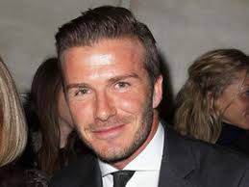
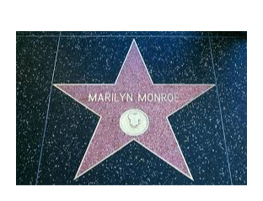
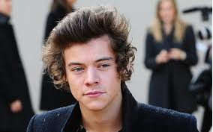

Slide 3
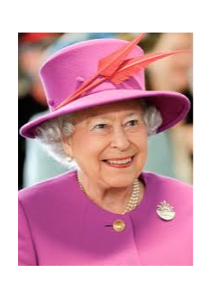
The Queen is very important.
If you met her, what would you ask her?

Slide 4
Who is the most important person you will ever talk to?
Have you got any ideas now?

Slide 6
When we think we remember to tear!
T - Thinking
E - Emotions - come with thoughts
A - Actions - come from our emotions
R - Results

Slide 7
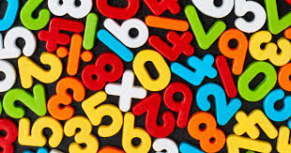
Imagine… Today’s maths task is really hard.
You could:
Think it is too hard.
Emotions are negative and upsetting.
Actions – we may give up and not try.
Results – no learning happens and we still don’t know what to do.

Slide 8
Or… The day could go like this:
You could:
Think this is hard but I will go for it.
Emotions are positive and happy.
Actions – we go for it and use adults to help and advise.
Results – we have learnt something new!
Tomorrow will be great!

Slide 9
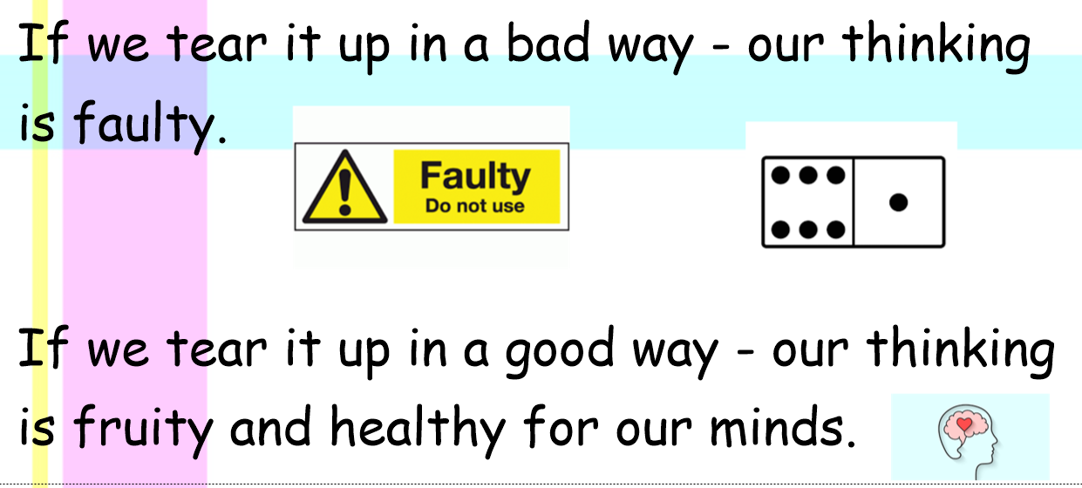

Slide 10
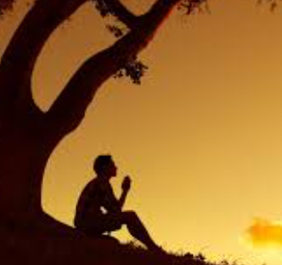

Slide 11
Our Christian Values can help us to do our positive TEAR:
Courage
Perseverance
Wisdom
Friendship
Respect
Trust

Slide 12
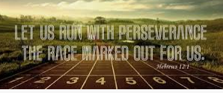
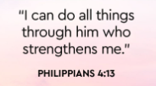
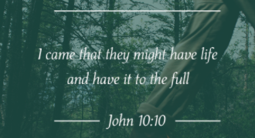
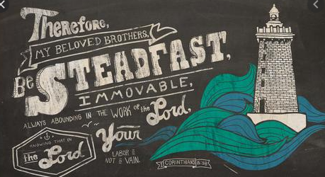
WWJD:

Slide 13
Prayer for Positivity and Perseverance
Lord Jesus,
Thank you for my life and the gift of learning you have given me. Help me to remember that in the challenges you are there. I have no need to worry. There is nothing that will ever happen that we cannot handle together.
In Jesus name,
Amen

