Slide 1
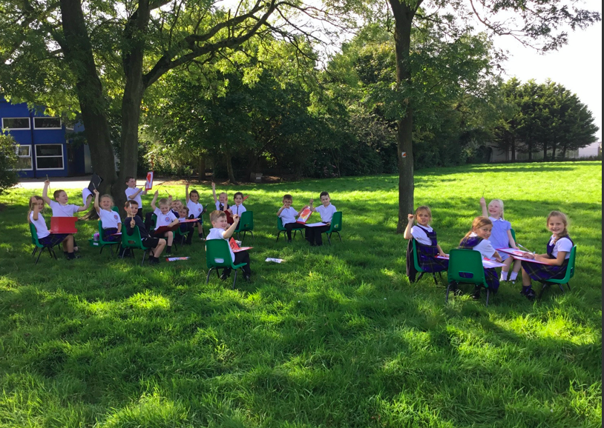
Welcome parents anD families
Mrs horn and mr pitcher

Slide 2
Website
https://www.hoolesmprimary.co.uk
Classes
Atlantis-What’s new?

Slide 3
Curriculum
Stimulating
Exciting
Hands on
Creative

Slide 4
Topics this term

Slide 5
Who’s here and when?
Mrs Horn- Mon-Wed
Mr Pitcher- Wed-Friday
Mrs Patel every morning supporting the children
Both of us are available to contact via ClassDojo and we both keep in contact with each other throughout the week incase we need to relay any messages.

Slide 6
tIMETABLE

Slide 7
CLASSDOJO
What do we use ClassDojo for?
How/when is best to contact us?

Slide 8
Homework and spellings
When?
How?
Issues?

Slide 9
Phonics and reading
Phonics is streamed to enable us to make sure that your child is being taught at the correct level for them. Occasionally phonics activities may be sent home. This may be because your child needs a little extra help with something or to consolidate learning.
Reading books need to be in school every Monday to be changed and then on a Thursday to be changed for over the weekend. Your child will also have a group guided reading session with Mrs Rishton twice every half term.
Please continue to listen to your child read at home. ☺

Slide 10
Key dates
Phonic screening check;
Year 2 children will be sitting their assessment in the Autumn term (beginning of December)
Year 1 children will be sitting their assessment at the end of the Summer term.

Slide 11
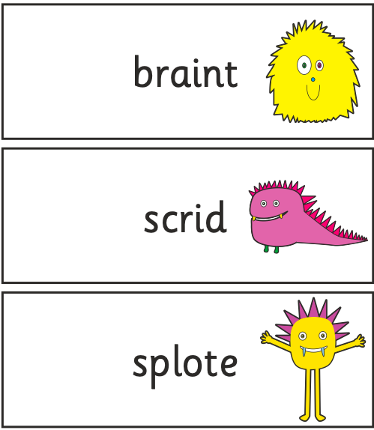
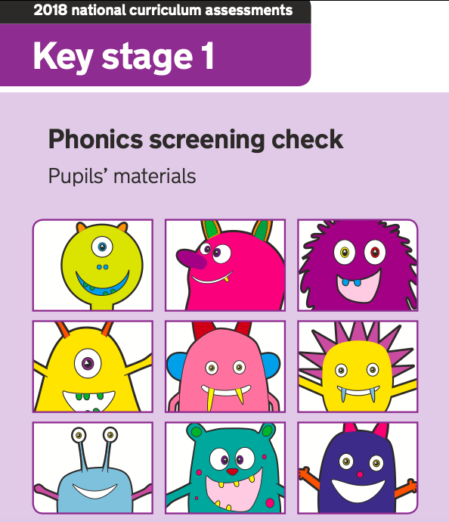
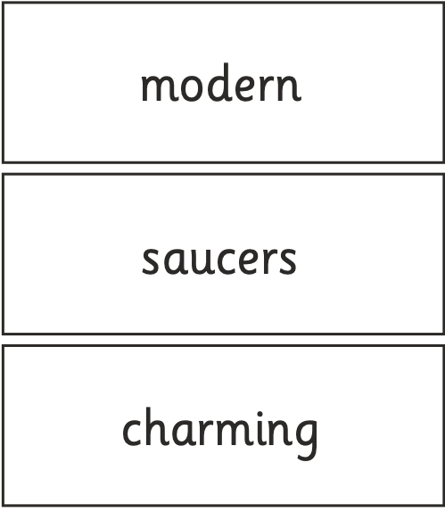
EXAMPLES OF THE SCREENING CHECK

Slide 12
How can parents help?
Communicate via Dojo and phone calls after schools
Useful websites and inks
www.phonicsplay.com
www.topmarks.com
www.bbcbitesize.com
www.oxfordowl.com

Slide 13
Google classroom
What is it?
How do you access it?
When will we use it?

Slide 14
Any questions?

